Slide 1
Categorizing Incident Reports with ML or LLM: A Data-Driven Approach
Md Shariar Imroze Khan
University of Koblenz
21st October 2024

Slide 2
Introduction
Importance of Incident Reporting: Incident reporting is a critical process in various industries. Process safety incidents tend to happen infrequently but can often have catastrophic results when things go wrong. ^{[1]}
Current Challenges: Manual classification leads to errors and inefficiencies.
Proposed Solution: Use ML or LLM to improve accuracy and reliability.

Slide 3
Literature Review
Manual Reporting Errors: Studies on human errors in incident reporting.
ML/LLM in Classification: Existing applications of ML or LLM in similar tasks.
Algorithm Effectiveness: Comparison of various algorithms in classification contexts.

Slide 4
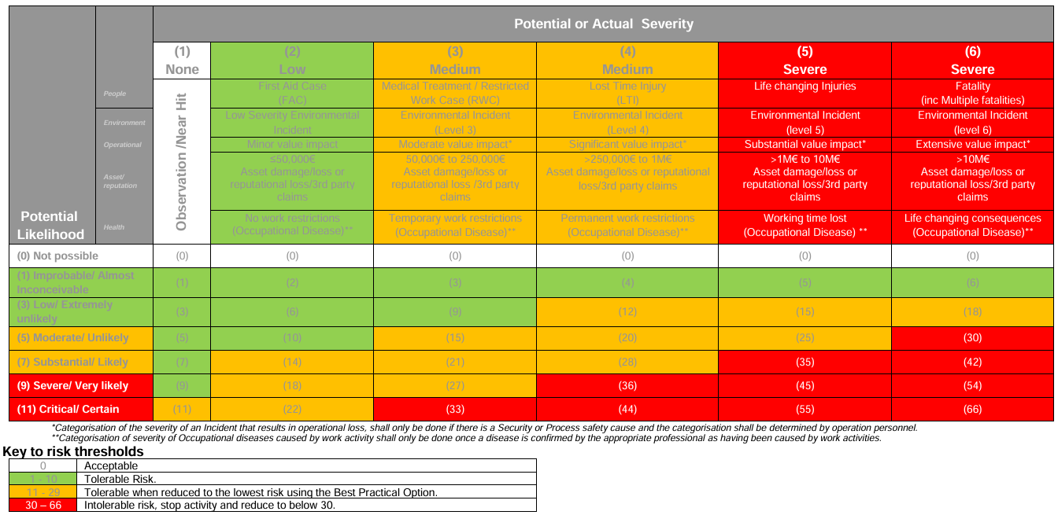
Safety Risk Matrix ^{[2]}
Confidential!

Slide 5
Problem Statement
Manual Reporting Issues: Subjective judgement, fatigue, lack of standardization.
Impact: Incorrect categorization affects data quality and decision-making.
Research Aim: Develop an ML or LLM based model to accurately classify incidents.

Slide 6
Objectives
Analyze Current Reporting Process: Identify common errors and inefficiencies. (Ongoing)
Develop ML/LLM Model: Classify incidents using historical data.
Evaluate Performance: Compare the performance of the machine learning/LLM model with manual classification using metrics such as accuracy, precision, recall, and F1-score.
Real-World Implementation: Assess impact on accuracy and efficiency.

Slide 7
Research Question
Research Objective(s) | Research question(s) | Methods per Research Question(s)
Correct recategorization of incident reports | Can ML methods correctly recategorize incident report? | Semantic search and Reclassification
 |  | Topic Modelling for Automatic Analysis
 |  | Named Entity Recognition (NER)
 | Can LLM model be used to enhance recategorization and help in decision making? | Generative Approach - Inferencing
 |  | LLM with Classification Head
 |  | Retrieval Augmented Generation
One of them can't use because the dataset is not big enough.

Slide 8
Methodology (ML-Based)
Data Collection: Gather historical incident reports.
Anonymization: Protect business-critical data.
Data Preprocessing: Clean and prepare data for analysis.
Model Development: Train ML models on pre-processed data.

Slide 9
Model Development (Semantic Search & Reclassification)
Adaptation: Use zero-shot and few-shot learning for new classifications.
Multilingual Embeddings: Enhance applicability in multilanguage settings.
Topic Modelling: Dynamic guided topic modelling for relevant clusters.

Slide 10
Model Development (Named Entity Recognition)
NER: Extract entities such as body parts using one-shot/few-shot learning and semantic search.
Steps:
Tokenization
Entity identification
Entity classification
Contextual analysis
Post-processing
Model Evaluation: Metrics - accuracy, precision, recall, F1-score.

Slide 11
Typical Issues and Solutions
Search Results: Fine-tune or create custom embeddings.
Reranking: Explore alternative approaches.
Topic Modelling: Prioritize guided topic modelling.
Trend Detection: Use automatic estimation methods.
Productive Usage: Implement delta or batch mode.

Slide 12
LLM-Pipeline 1: Generative Approach (Zero-shot Inferencing)
Step 1: Collect and Anonymize Data:
Data Collection: Gather a diverse set of incident reports from various sources.
Anonymization: Remove or mask any sensitive information to ensure privacy and compliance with data protection regulations.
Step 2: Inferencing:
Model Selection: Use a large language model (LLM) such as LLaMA 3.21B, which can generate text based on the input it receives.
Zero-shot Inferencing: This approach involves using the LLM to generate responses or classifications without any prior training on the specific dataset. The model leverages its pre-existing knowledge to infer the most likely output.
Step 3: Analysing Output
Generated Text: The LLM model produces text that attempts to classify or describe the incident reports based on its understanding. This text can be used for further analysis or as a preliminary classification.

Slide 13
LLM-Pipeline 2: Classification Head (Finetuning)
Step 1: Collect and Anonymize Data
Data Collection: Like Pipeline 1, gather incident reports/data.
Anonymization: Ensure all data is anonymized to protect sensitive information.
Step 2: LLM with Classification Head (Finetuning)
Model Selection: Choose an LLM that supports adding a classification head, which is a layer specifically designed for classification tasks.
Finetuning: Train the LLM on the collected dataset, adjusting the model’s parameters to improve its performance on the specific task of incident classification. This involves supervised learning where the model learns from labelled examples.
Step 3: Analysing Output
Classification: The finetuned model outputs a classification for each incident report, categorizing them into predefined classes based on the training it received.

Slide 14
LLM-Pipeline 3: Retrieval Augmented Generation (RAG)
Step 1: Input
Data Collection: Collect incident reports as in the previous pipelines.
Preprocessing for Class Verification: Prepare the data to ensure it is suitable for the RAG process, which may involve cleaning and structuring the data.
Step 2: LLM with RAG
Model Selection: Use an LLM integrated with a Retrieval Augmented Generation (RAG) framework. RAG combines the strengths of retrieval-based and generative models.
Retrieval Component: The model retrieves relevant documents or data points from a large corpus that can help in generating a more accurate and contextually relevant response.
Generation Component: The LLM then generates text based on the retrieved information, enhancing the quality and relevance of the output.
Step 3: Classifier (Combined Classes)
Classification: After generating the text, a classifier is used to categorize the incidents into combined classes. This step ensures that the generated text is aligned with the predefined classification schema.
Step 4: Analysing Output
Class: The final output is a class label for each incident report, determined by the combined efforts of retrieval, generation, and classification processes.

Slide 15
Timeline
Month 1: Literature review, data collection, site visit.
Month 2: Data pre-processing.
Month 3: Model development.
Month 4: Model evaluation and refinement.
Month 5: Implementation and testing in a real-world setting.
Month 6: Analysis of results and thesis writing.

Slide 16
References
[1] Guide to Process Safety
[2] Process Description
[3] (16) Ping | Process Safety Community
[4] Home - Integrated Management System
[5] PDCA – 12
[6] Guidance document for F12.01.02 Incident Learning Form - HSSE and Process Safety Learning (EN).pdf
[7] [SentenceTransformers Documentation — Sentence Transformers documentation (sbert.net)](https://sbert.net/)
[8] [OneHotEncoder — scikit-learn 1.5.2 documentation](https://scikit-learn.org/stable/modules/generated/sklearn.preprocessing.OneHotEncoder.html)
[9] [SetFit (huggingface.co)](https://huggingface.co/docs/setfit/en/index)
[10] [Transformers (huggingface.co)](https://huggingface.co/docs/transformers/index)
[11] [Introduction - Hugging Face NLP Course](https://huggingface.co/learn/nlp-course/en/chapter1/1)
[12] Introducing Llama 2 on Azure
[13] [Add a classification head to a fine-tuned language model - Beginners - Hugging Face Forums](https://discuss.huggingface.co/t/add-a-classification-head-to-a-fine-tuned-language-model/8176)
[14] [What is Retrieval Augmented Generation (RAG)? | Databricks](https://www.databricks.com/glossary/retrieval-augmented-generation-rag)
[15] [meta-llama/Llama-3.2-1B · Hugging Face](https://huggingface.co/meta-llama/Llama-3.2-1B)

